Slide 1
BRAIN TUMOR DETECTION USING -CNN
Nara Uttej
REG NO:211521243174
COLLAGE:Panimalar institute of technology
MAIL ID:narauttej01@gmail.com
3/21/2024 Annual Review
1

Slide 2
PROJECT
TITLE:
BRAIN TUMOR DETECTION
USING -CNN
3/21/2024 Annual Review
2

Slide 3

AGENDA
1. Introduction & Objectives
2. Literature Review
3. Methodology & System Architecture
4. Implementation & Evaluation
5. Results, Analysis & Future Work
6. Conclusion & Q&A
3/21/2024 Annual Review
3

Slide 4
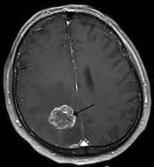
PROBLEM
STATEMENT
Brain tumors, abnormal growths within the brain or its surrounding tissues, necessitate
Early diagnosis for effective treatment. Medical imaging, particularly Magnetic Resonance
Imaging (MRI), plays a pivotal role in identifying these tumors. However, manual analysis by radiologists is time-consuming and prone to errors. Leveraging Convolutional Neural Networks (CNNs), we aim to develop an automated system that accurately detects brain tumors in MRI images. Challenges include the brain’s complex anatomy, variability in tumor characteristics, and class imbalance. Our proposed approach involves data preparation, designing NN architectures, training, and post-processing
Detecting brain tumors from medical images, such as
MRI scans, is crucial for early diagnosis and effective
treatment. However, manual identification of tumor
regions can be time-consuming and prone to human
error. Therefore , the goal is to develop an automated
system that accurately detects brain tumors in MRI
images using deep learning techniques.
3/21/2024 Annual Review
4

Slide 5

PROJECT
OVERVIEW
A brain tumor detection system aims to predict whether a given brain MRI image
contains a tumor . Hospitals utilize such systems to assist doctors in diagnosing patients.
The process involves taking an MRI scan of a patient’s brain, feeding the image into the
system, and determining whether a tumor is present. Given the critical nature of this
task, achieving high accuracy is paramount.
Convolutional Neural Networks (CNNs) play a crucial role in this task. These networks excel at analyzing images and extracting relevant features. The CNN architecture includes input layers, convolutional layers, pooling layers, and fully connected layers. During training, labeled brain MRI images are used to teach the model to differentiate between tumor and non-tumor images. The accuracy of this system directly impacts patient outcomes, contributing to early tumor detection and improved prognosis .
3/21/2024 Annual Review
5

Slide 6

WHO
ARE
THE
END
USERS?
The end users for projects related to brain tumor detection using Convolutional Neural Networks (CNN) can vary based on the specific context and implementation. Here are some potential end user groups:
Medical Professionals and Radiologists
Healthcare Institutions and Hospitals
Researchers and Data Scientists
Patients and Caregivers
Health Tech Companies and Developers
Public Health Agencies and Policy Makers
3/21/2024 Annual Review
6

Slide 7
YOUR
SOLUTION
>We propose an automated brain tumor recognition system based on CNNs.
>The system analyes MRI images and classifies them into tumorous and non-tumorous classes.
>Various CNN architectures (such as Alexnet, VGG-16, GooGLeNet, and RNN) are explored and compared.
>Hyperparameter tuning is crucial for optimizing model performance.
VALUE
PROPOSITION
High Accuracy: Our system achieves an accuracy of 98.67% using CNN Alexnet on test data.
Precision: Accurate segmentation of brain MRI images aids medical practitioners in treatment planning.
Time Efficiency: Automated detection reduces the manual effort required for tumor identification.
Lifesaving Impact: Early detection enhances treatment opportunities and patient outcomes
3/21/2024 Annual Review
7

Slide 8
THE
WOW
IN
YOUR
SOLUTION
The Tumor’s Veil: A rogue cell awakens, a rebel in disguise, It multiplies, defying the brain’s harmonious ties. A tumor blooms, insidious and sly, Its tendrils reaching for the azure sky.
The Healer’s Quest: Enter the white-coated warriors, resolute and keen, Their weapons: pixels, layers, and neural routines. They wield Convolutional Shields, their armor strong, To pierce the veil, unravel the tumor’s wrong.
The Dance of Pixels: In MRI’s canvas, they seek the hidden foe, Each pixel a clue, a whispered echo. Layers of neurons convolve, patterns emerge, Tumor or healthy tissue? The truth they urge.
The Oracle of Accuracy: “98.67%,” proclaims the Oracle’s decree, A model trained on data, a digital symphony. Precision and recall, metrics of grace, Guiding the surgeon’s hand in this life-saving chase.
The Surgeon’s Symphony: In the sterile theater, under fluorescent light, The surgeon wields her scalpel, steady and bright. She navigates the brain’s labyrinthine maze, Trusting the CNN’s whispers, its intricate phrase.
The Gift of Time: Minutes saved, futures rewritten, As tumors yield to algorithms, their grip smitten. Early detection, hope rekindled, A patient’s journey altered, destiny dwindled.
8

Slide 9
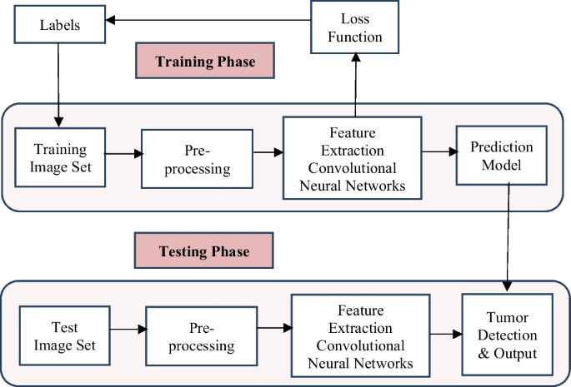
MODELLING:
3/21/2024 Annual Review
9

Slide 10
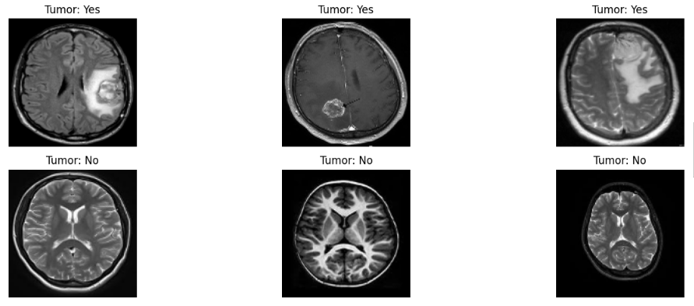
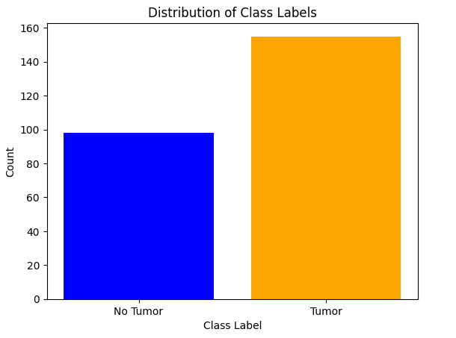
MODELLING:
3/21/2024 Annual Review
9

Slide 11
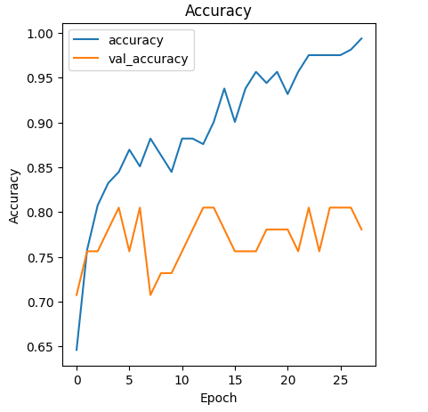
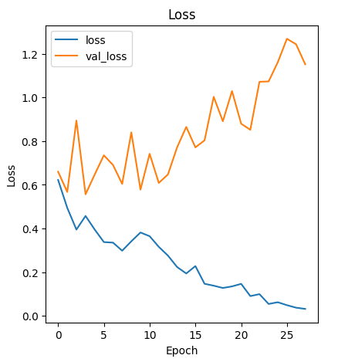
RESULTS
Brain tumors are elusive adversaries, varying in position, mass, and nature. Detecting them manually from voluminous MRI data is arduous and time-consuming.
Impressive Accuracy
On datasets like BRATS 2013, BRATS 2015, and OPEN I, the CNN Alexnet achieves an astounding accuracy of 98.67% in automatic brain tumor detection.
3/21/2024 Annual Review
10

